Slide 1
PARCEL MANAGEMENT SYSTEM
UIT2201 – SOFTWARE DEVELOPMENT PROJECT – I
A PROJECT PRESENTATION

Slide 2
TEAM MEMBERS AND ROLES
KARTHICK V -SCRUM MASTER
KARUNAGARAN R -DEVELOPER
KAUSHIK A -OWNER
HEMASRI K V -DEVELOPER
KAVIN V -DEVELOPER
KAVIYAPRIYA K -TESTER
KAYATHRI R -DEVELOPER

Slide 3
PROBLEM STATEMENT
A parcel service office wants to develop a system to manage their dispatch service. The parcel should be assigned a unique tracking number using which the status of the parcel can be tracked
The sender and the receiver address, and contact details have to be maintained in the system
Once the parcel has reached the destination office, the sender and the receiver should be notified
It should be possible to fetch a location and date-wise list of deliveries from the system
Even after completion of the delivery, the system should be able fetch the relevant details using the tracking number

Slide 4
REQUIREMENT ANALYSIS
.Unique tracking number should be assigned for each booked parcel
Login management plays a crucial role to store sender and receivers address ,contact details and login.
Tracking management helps to find the status of package.
Notification management should notifies both sender and receiver once the parcel Is delivered
The details stored should be retrievable by both the customer and admin
The delivery date for each parcel should be stored

Slide 5
DESIGN DIAGRAM
PARCEL SERVICE MANAGEMENT
PARCEL_BOOKING
PINCODE_UPDATES
ADMIN
PARCEL_DETAILS MANAGEMENT
CUSTOMER
STATUS_TRACKING

Slide 6
CLIENT DETAILS
NAME : R. SIVASHANKAR
DESIGNATION : COUNTER CLERK, ADMINISTRATION EMPLOYEE, TN
PROFESSIONAL COURIER CENTRE, DINDUGUL
ADDRESS : POLICE STATION COLONY, SINGAMPUNARI, DINDUGUL.
MOBILE NUMBER : 9487938181

Slide 7
ADMIN LOGIN MODULE
DATA STRUCTURE USED -ARRAY
CONSTRUCTED FOR -ADMINISTRATION SIDE
INPUT -TRACKING NUMBER
DELIVERABLES - DETAILS OF THE PARCEL INCLUDING DELIVERED DATE PINCODE,NAME AND DESITNATION
REPRESENTATION -TRAVERSING ARRAY ,RETRIEVING THE MATCHED TRACKING NUMBER

Slide 8
ABSTRACTION OF DATA RETRIEVAL
0 INDEX [KAVIYA,KV COLONY,KARAIKUDI, 620003,9807654321] | 1 INDEX [RAM,CKK COLONY,COIMBATORE, 646001,908762345] | 2 INDEX [VENKATESH,PARIS COLONY,TRICHY,620001, ]6789012345
[RAM,CKK COLONY,COIMBATORE, 646001,908762345]
0TH INDEX 20223456 | 1 INDEX 20223768 | 2 INDEX
INPUT
20223768

Slide 9
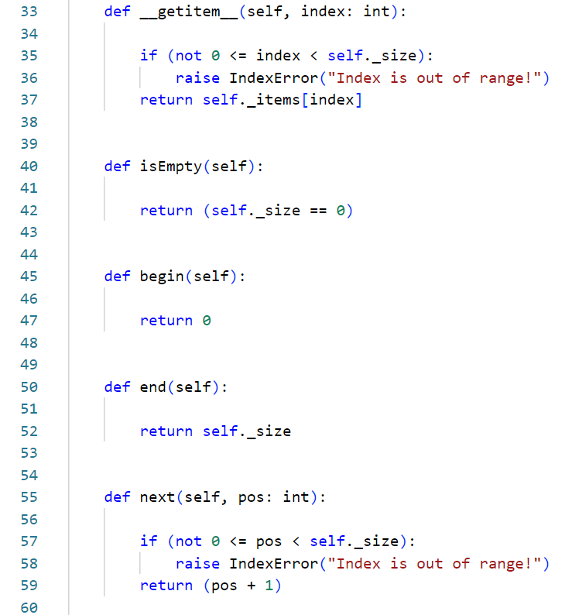
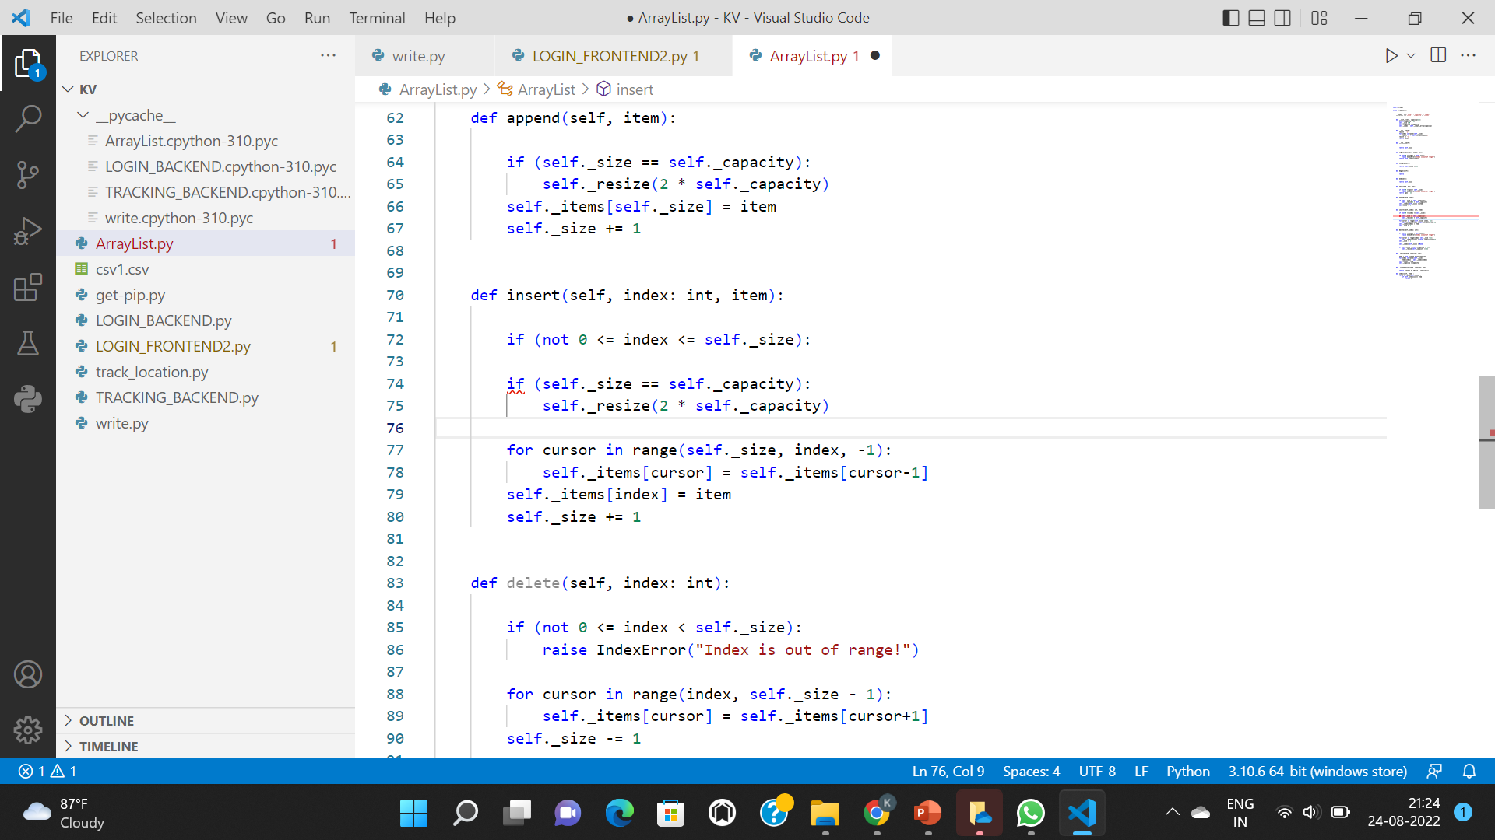
CODE SNIPPETS…..

Slide 10
CUSTOMER LOGIN MODULE
DATA STRUCTURE USED -DOUBLY LINKED LIST,ARRAY,DICTIONARY
CONSTRUCTED FOR -CUSTOMER
SUBMODULES -PARCEL_BOOKING
-STATUS_TRACKING
-DATEWISE_DELIVERIES

Slide 11
1.PARCEL_BOOKING
DATA STRUCTURE USED -TWO ARRAYS
CONSTRUCTED FOR -CUSTOMER SIDE
INPUT -TRACKING NUMBER
DELIVERABLES -STORING THE DETAILS OF THE PARCEL IN 1ST ARRAY
-STORING GENERATED UNIQUE TRACKING NUMBER IN 2ND ARRAY
-CHECKING THE CORRECTNES FOR DETAIL
-NOTIFICATION FOR PARCEL BOOKED

Slide 12
ABSTRACTIONS FOR THE DATA STRUCTURE
ARRAY 1 STORES DETAILS
INPUTS
[SENDER NAME
ADDRESS
PINCODE
PLACE
CONTACT DETAILS
RECEIVERS……..]
ARRAY 2 STORES TRACKING NUMBER ALONE
GENERATED TRACKING NUMBER

Slide 13
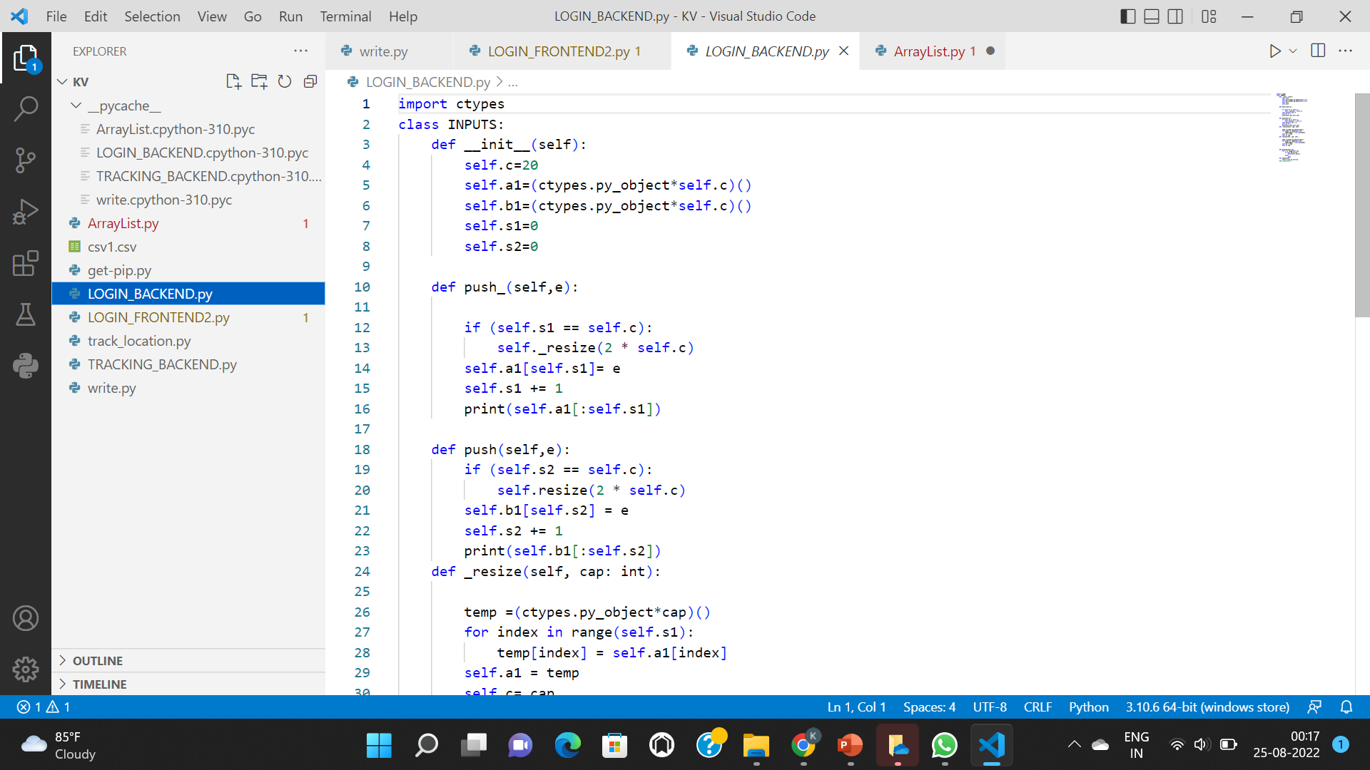
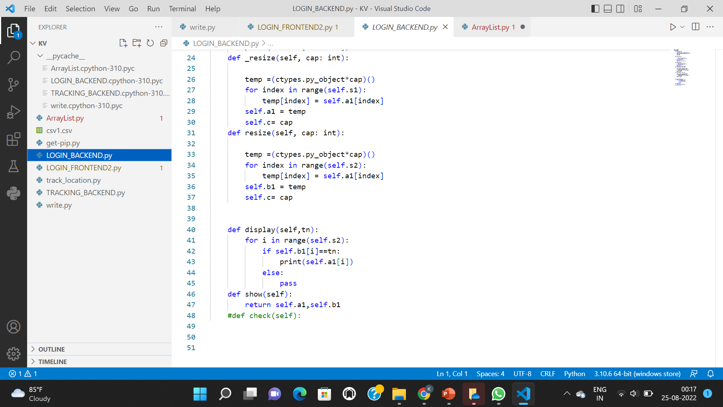
CODE SNIPPETS

Slide 14
2.STATUS_TRACKING
DATA STRUCTURE USED -DOUBLY LINKED LIST
CONSTRUCTED FOR -CUSTOMER SERVICE
INPUT -GENERATED TRACKING NUMBER
DELIVERABLES -LINKED LIST NODE WILL HAVE 4 FIELDS
-LIST CONTAINING PINCODE AND THE LOCATION,STATUS DEFAULTLY AS FALSE,LIST OF TRACKING NUMBERING DELIVERING TO THE PARTICULAR LOCATION RESPECTIVELY

Slide 15
ABSTRACTION FOR DOUBLY LINKED LIST NODE
PREVIOUS NODE REFERENCE | [PINCODE,LOCATION NAME] | FALSE | [TRACKING NUMBERS..] | NEXT NODE REFERENCE
INITIALLY THE STRUCTURE WILL BE
PREVIOUS NODE REFERENCE | [] | FALSE | [] | NEXT NODE REFERENCE

Slide 16
WORKING OF STATUS TRACKING MODULE
STEP 1:
EXAMPLE:
DESTINATION PINCODE AND NAME,TRACKING NUMBER FROM PARCEL BOOKING MODULE WILL BE STORED
DUMMY HEADER | [MADURAI,625001]] | FALSE | [20223456, 20226897,20225690]
 | [TRICHY, 620001] | FALSE | [20223478,20227689,2022896 | NEXT NODE REFERENCE

Slide 17
WORKING OF STATUS TRACKING MODULE
INPUT:
TRAVERSING AND FINDIN THE TRICHY NODE:
TRACKING NUMBER -20227689
DESTINATIO-TRICHY
DUMMY HEADER | [MADURAI,625001]] | FALSE | [20223456, 20226897,20225690]
 | [TRICHY, 620001] | FALSE | [20223478,20227689,2022896 | NEXT NODE REFERENCE
OUTPUT
PREVIOUS NODE REFERENCE | [TRICHY,620001] | TRUE | [20223478,20227689,2022896] | NEXT NODE REFERENCE

Slide 18
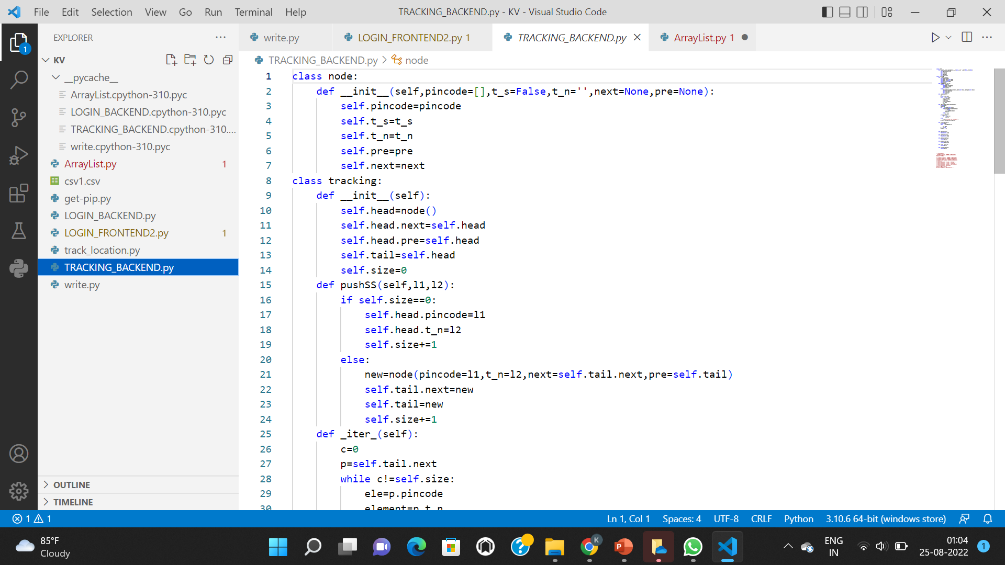
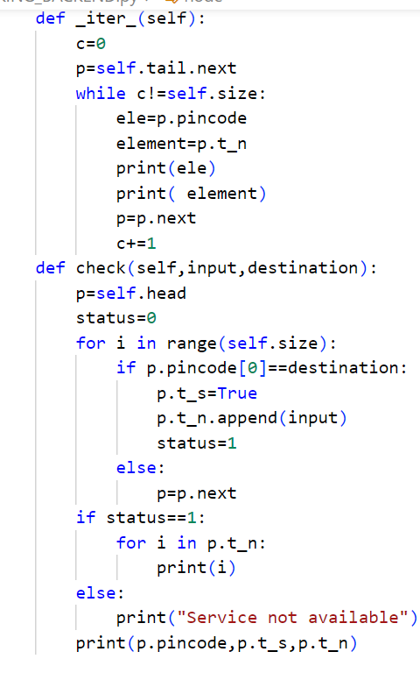
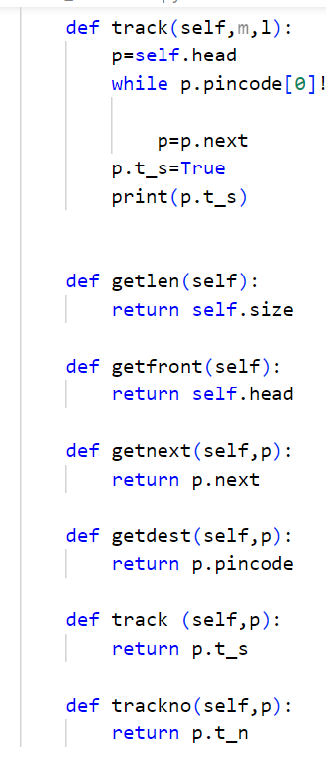
CODE SNIPPETS

Slide 19
3.DATEWISE_DELIVERIES
DATA STRUCTURE -RETRIEVING FROM DOUBLY LINKED LIST
CONSTRUCTED FOR -CUSTOMER SERVICE
INPUT -PINCODE
DELIVERABLES -THE DOUBLY LINKED LIST WILL BE AGAIN TRAVERSED
-PINCODE MATCHES THE NODE CORESSPONDING NAME ,TRACKING NUMBER LIST WILL BE DISPLAYED IN TREEVIEW

Slide 20
ABSTRACTION FOR RETRIEVING DATA FROM DATA STRUCTURE
INPUT:
TRAVERSING AND FINDIN THE TRICHY NODE:
PINCODE-620001
DUMMY HEADER | [MADURAI,625001]] | FALSE | [20223456, 20226897,20225690]
 | [TRICHY, 620001] | FALSE | [20223478,20227689,2022896 | NEXT NODE REFERENCE
OUTPUT
HK PARCEL SERVICE
620001 | TRICHY | [20223478, 20227689, 2022896

Slide 21
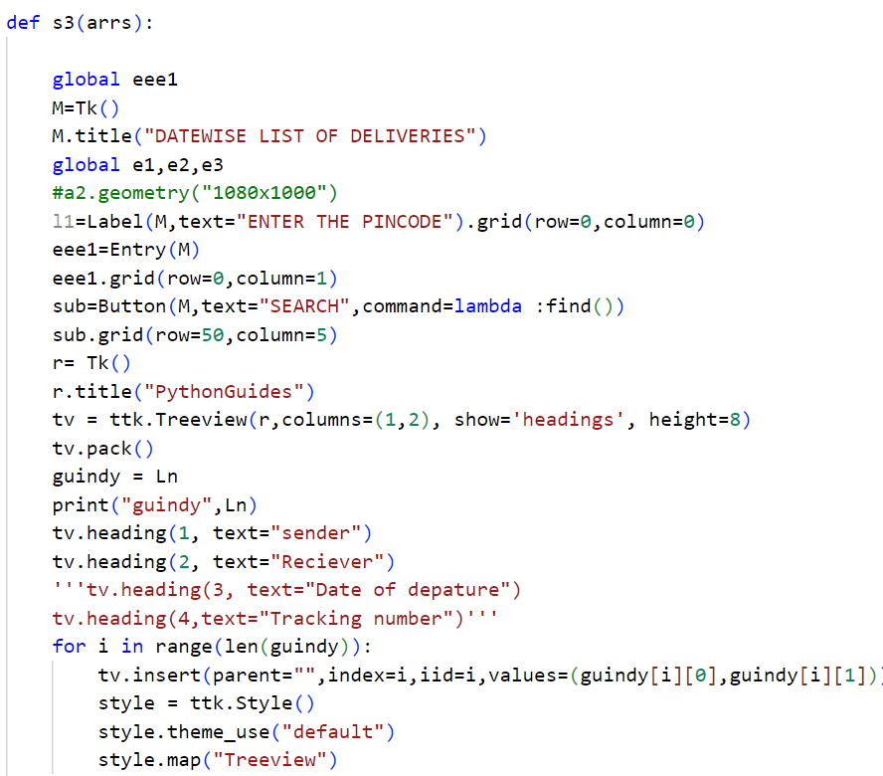
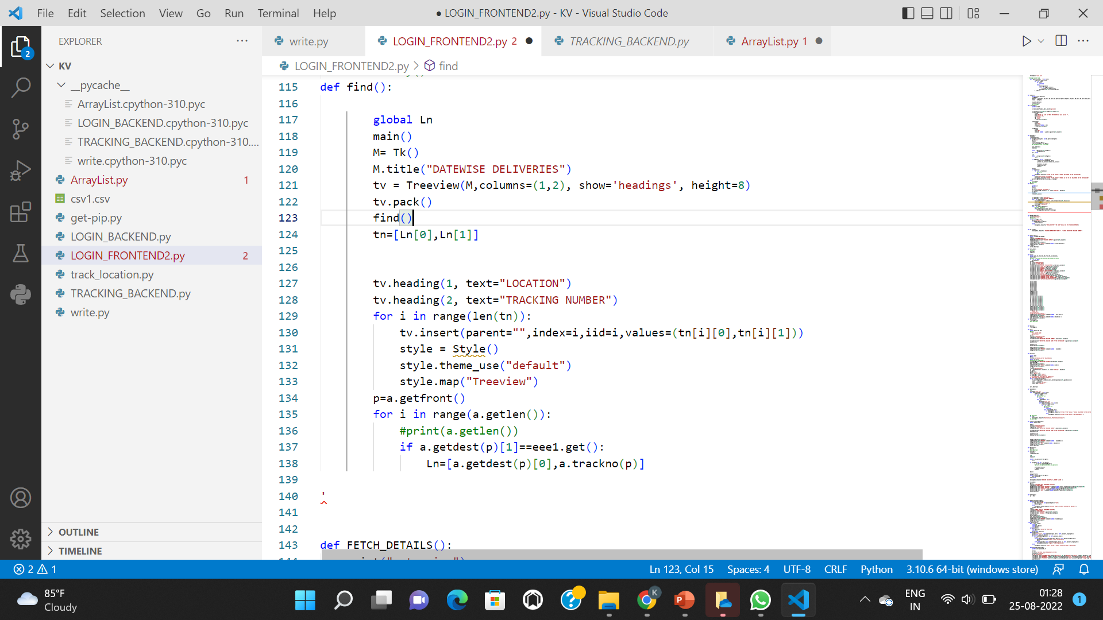
CODE SNIPPETS

Slide 22
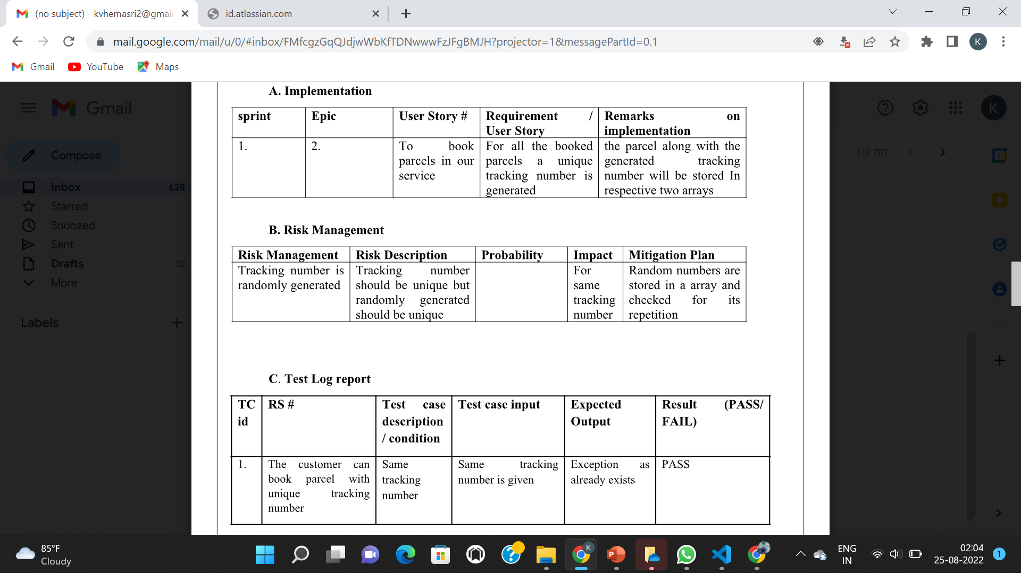
IMPLEMENTATION AND RISK MANAGEMENT
NAME : KARTHICK V-3122215002045, KAUSHIK A-3122215002046
ROLE IN PROJECT : SCRUM MASTER AND DEVELOPER,OWNER AND DEVELOPER
.

Slide 23
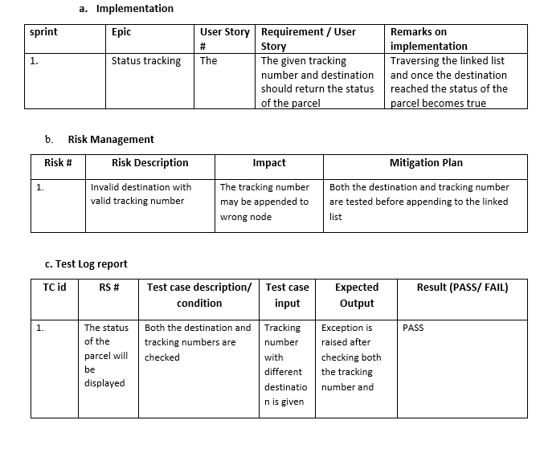
NAME : KAVIYAPRIYA K 3122215002050
ROLE IN PROJECT : TESTERVAND DEVELOPER

Slide 24
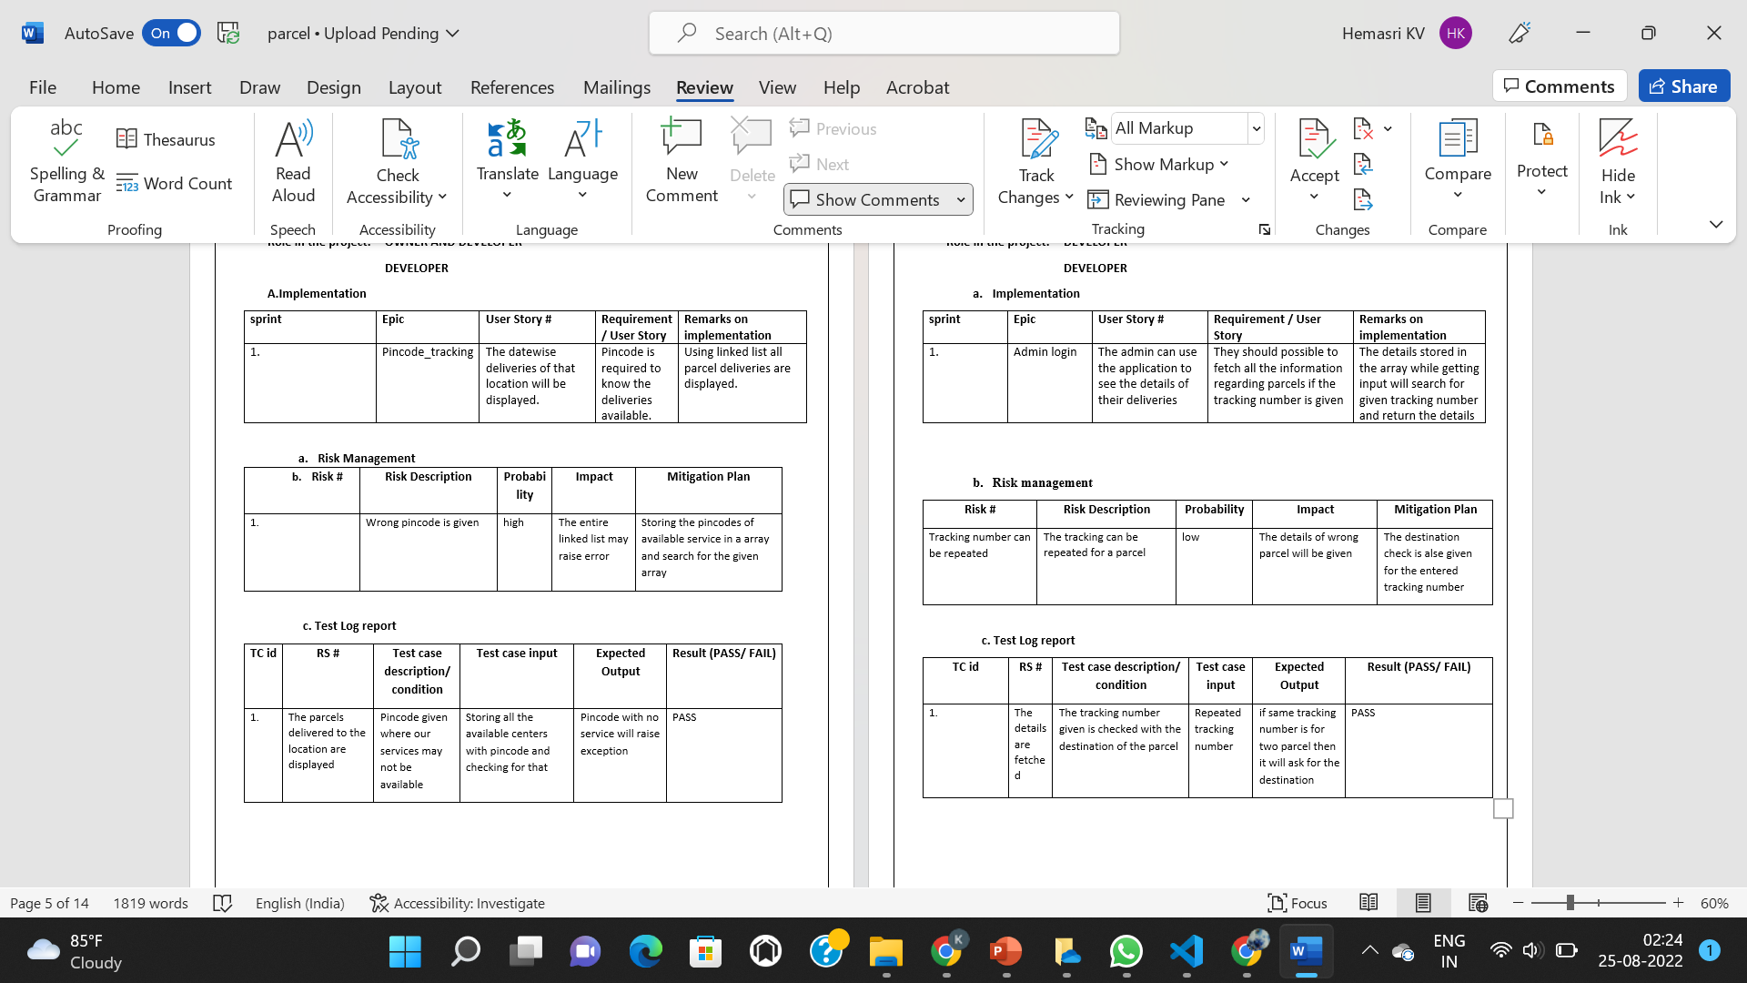
NAME : K.V.HEMASRI-3122215002048,KARUNAGARAN R- 3122215002046
ROLE IN PROJECT : DEVELOPER AND DEVELOPER RESPECTIVELY

Slide 25
NAME :KAYATHRI R-3122215002051,KAVIN V-3122215002049
ROLE IN PROJECT : DEVELOPER AND DEVELOPER RESPECTIVELY

Slide 26
CLASS DIAGRAM
Class pincode_updates:
Size,head,tail
Screen_3(),find(),treeview()
Class parcel_detail management:
Size,capacity,array
Admin_login(),proceeding_admin(),getitem(),fetch_details(),getend()

Slide 27
CLASS DIAGRAM
Class parcel_booking:
Size, details_array, trackno._array
Push(),resize()
Class status_tracking:
Head, size, tail
Push(),check(),track(), trackno(), gethead(),getfront(),getdest(),getend()

Slide 28
FUTURE WORK
The bill can be displayed
The details of the delivery person can be displayed to the customer once the parcel has reached the destination office
If the parcel management has failed to deliver the parcel at correct location free delivery to the desire address can be done
Fleet Management
This feature is needed if your company has its own fleet of delivery vehicles. In this case, it’s better to build a courier management software with the possibility to manage these vehicles as well.

Slide 29
CONCLUSIONS
The project titled ‘Courier Management Service’ was developed to the courier services and direction and with their help. The system was tested and the performance of the system was found to be acceptable. All the necessary output was created. The system was found to be user-friendly with a help message for the customer.
The menu Driven Architecture of the system provide an easy-to-use environment for the users. The system was implemented successfully. The manpower and working hours needed to operate the system were less and it was seen to be more secure. Thus, the project was completed successfully.

